Slide 1
MaineCat Environment
MaineCat
(InnReach)
Colby, Bates, Bowdoin (Sierra)
Apollo Libraries
(via API – TBD
PPL
(Sierra)
KOHA Libraries
(via API – TBD
PPL
(Sierra)
UNE
(Sierra)
Evergreen Libraries
(via API – TBD)
URSUS
(Sierra)
Minerva
(Sierra)
MILS:
Maine InfoNet Library System
(Sierra)
Independent
Library Systems
not directly
connected to
MaineCat
Requesting via
ARRC Library

Slide 2
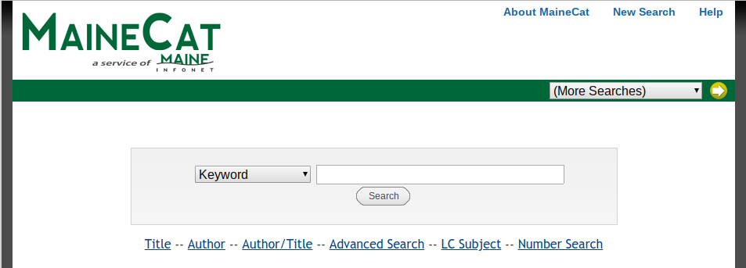

Slide 3
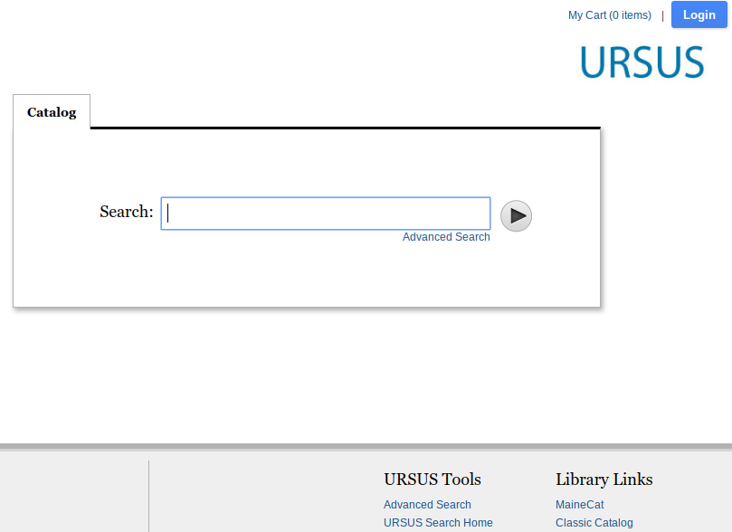

Slide 4
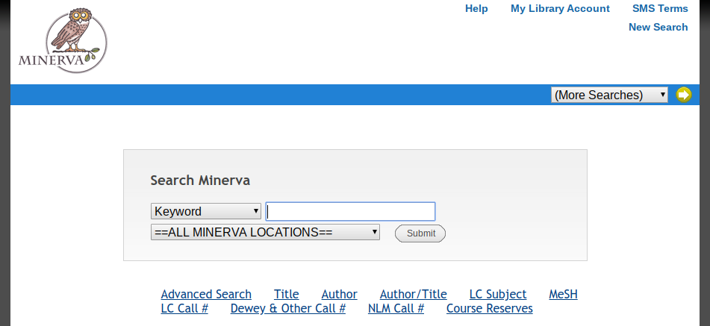

Slide 5
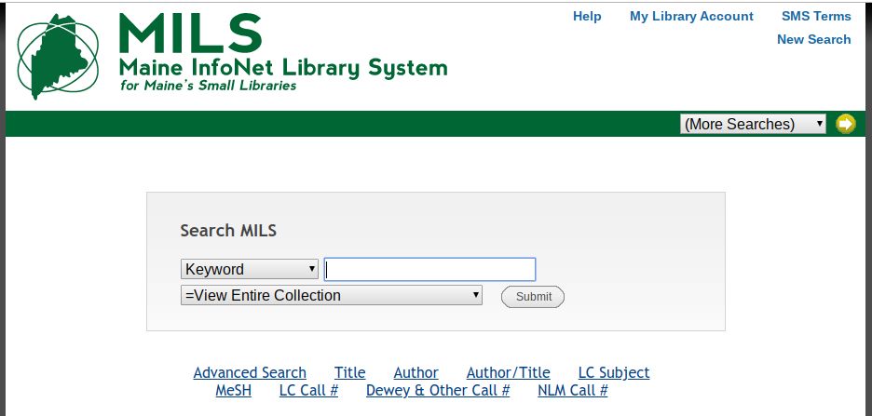

Slide 6
Maine InfoNet Systems
URSUS - UMaine System Libraries, Maine State Library, Maine Law and Legislative Library, & Bangor Public Library
Minerva - 59 Public, Academic, School, & Special Libraries
MILS - 20 Smaller Public and Academic Libraries

Slide 7
D2IR API
Direct to INNReach API
Bi-directional set of calls and responses
Allows for :
Records to be loaded into MaineCat
Patrons to request items directly through MaineCat
Items to be directly requested through MaineCat

Slide 8
