Slide 1

Too Old for Storytime, Too Young for Soldering
Programming for Ages 5-8

Slide 2
What are some traits of this age group?
5 year olds
  Sweet, nice to a little wild. Still learning how to read and manage themselves.
6 year olds
  Trying to balance knowing choices with what they can actually do. Often stubborn. Learning to read and tell time.
7 year olds
  Moody, emotional, gains new fears but also gains the ability to persevere.
8 year olds
  World is expanding, starting to understand what adults say. Usually has a clear concept of time and ability to follow directions.
From the “Your # Year Old” by Louise Bates Ames

Slide 3
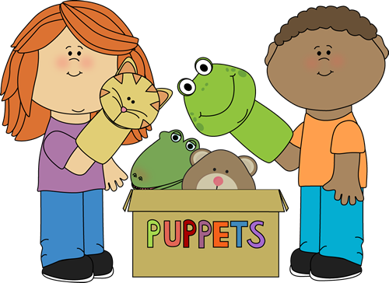
Do you find yourself skipping this age group?
Not old enough to be alone in the library
Not always independent
Sometimes you just forget!
So what can you do with them?

Slide 4
Busy Builders/Brick Builders/ LegoTM Club
Still love Legos
Parents can be in the room (and sometimes build too!)
Usually can get Legos or other building supplies through donations or cheaply at secondhand stores
Free-build or challenge style

Slide 5
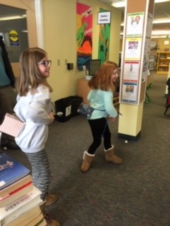
Minute to Win It Games
Simple yet silly
Parents can participate
May need to scale in different ways
  A spelling related one could change to just one letter
  May need to use fewer cups for stacking challenges

Slide 6
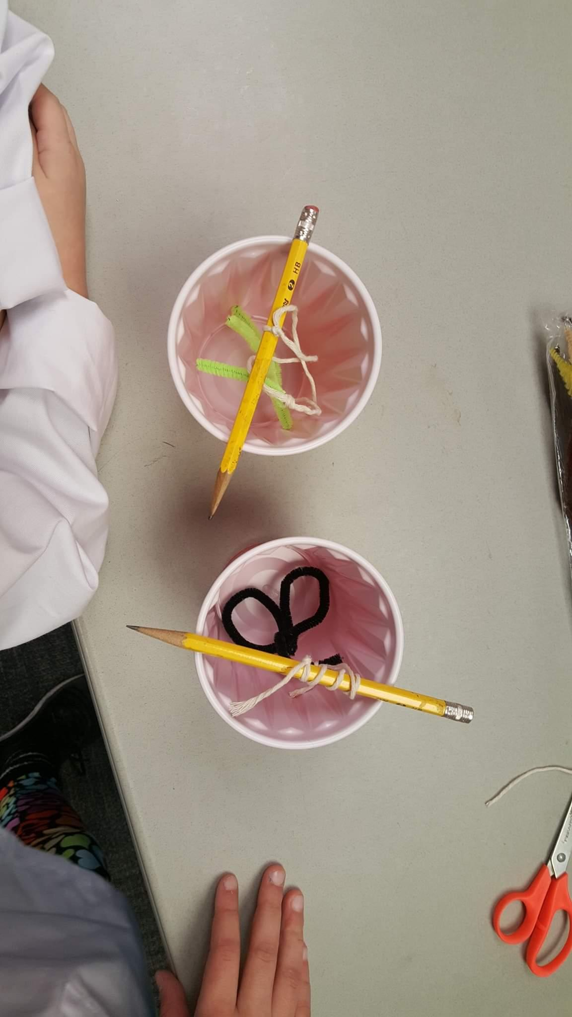
Fairy Tale STEM/STEAM
Bridge the gap between storytime and other programming
Can tie together different versions of stories
Lots of ideas on Pinterest
  https://fairytalesteam.blogspot.com

Slide 7
Tinkering/Little Makers
Open ended contraption making
  https://confidencemeetsparenting.com/tinkering-station/
May need more guidance/help than you are used to, so involve the parents!
Plenty of more specific ideas
  https://steminlibraries.com/tag/grades-1-3/
  https://showmelibrarian.blogspot.com/p/all-things-steam.html
  Bedtime Math

Slide 8
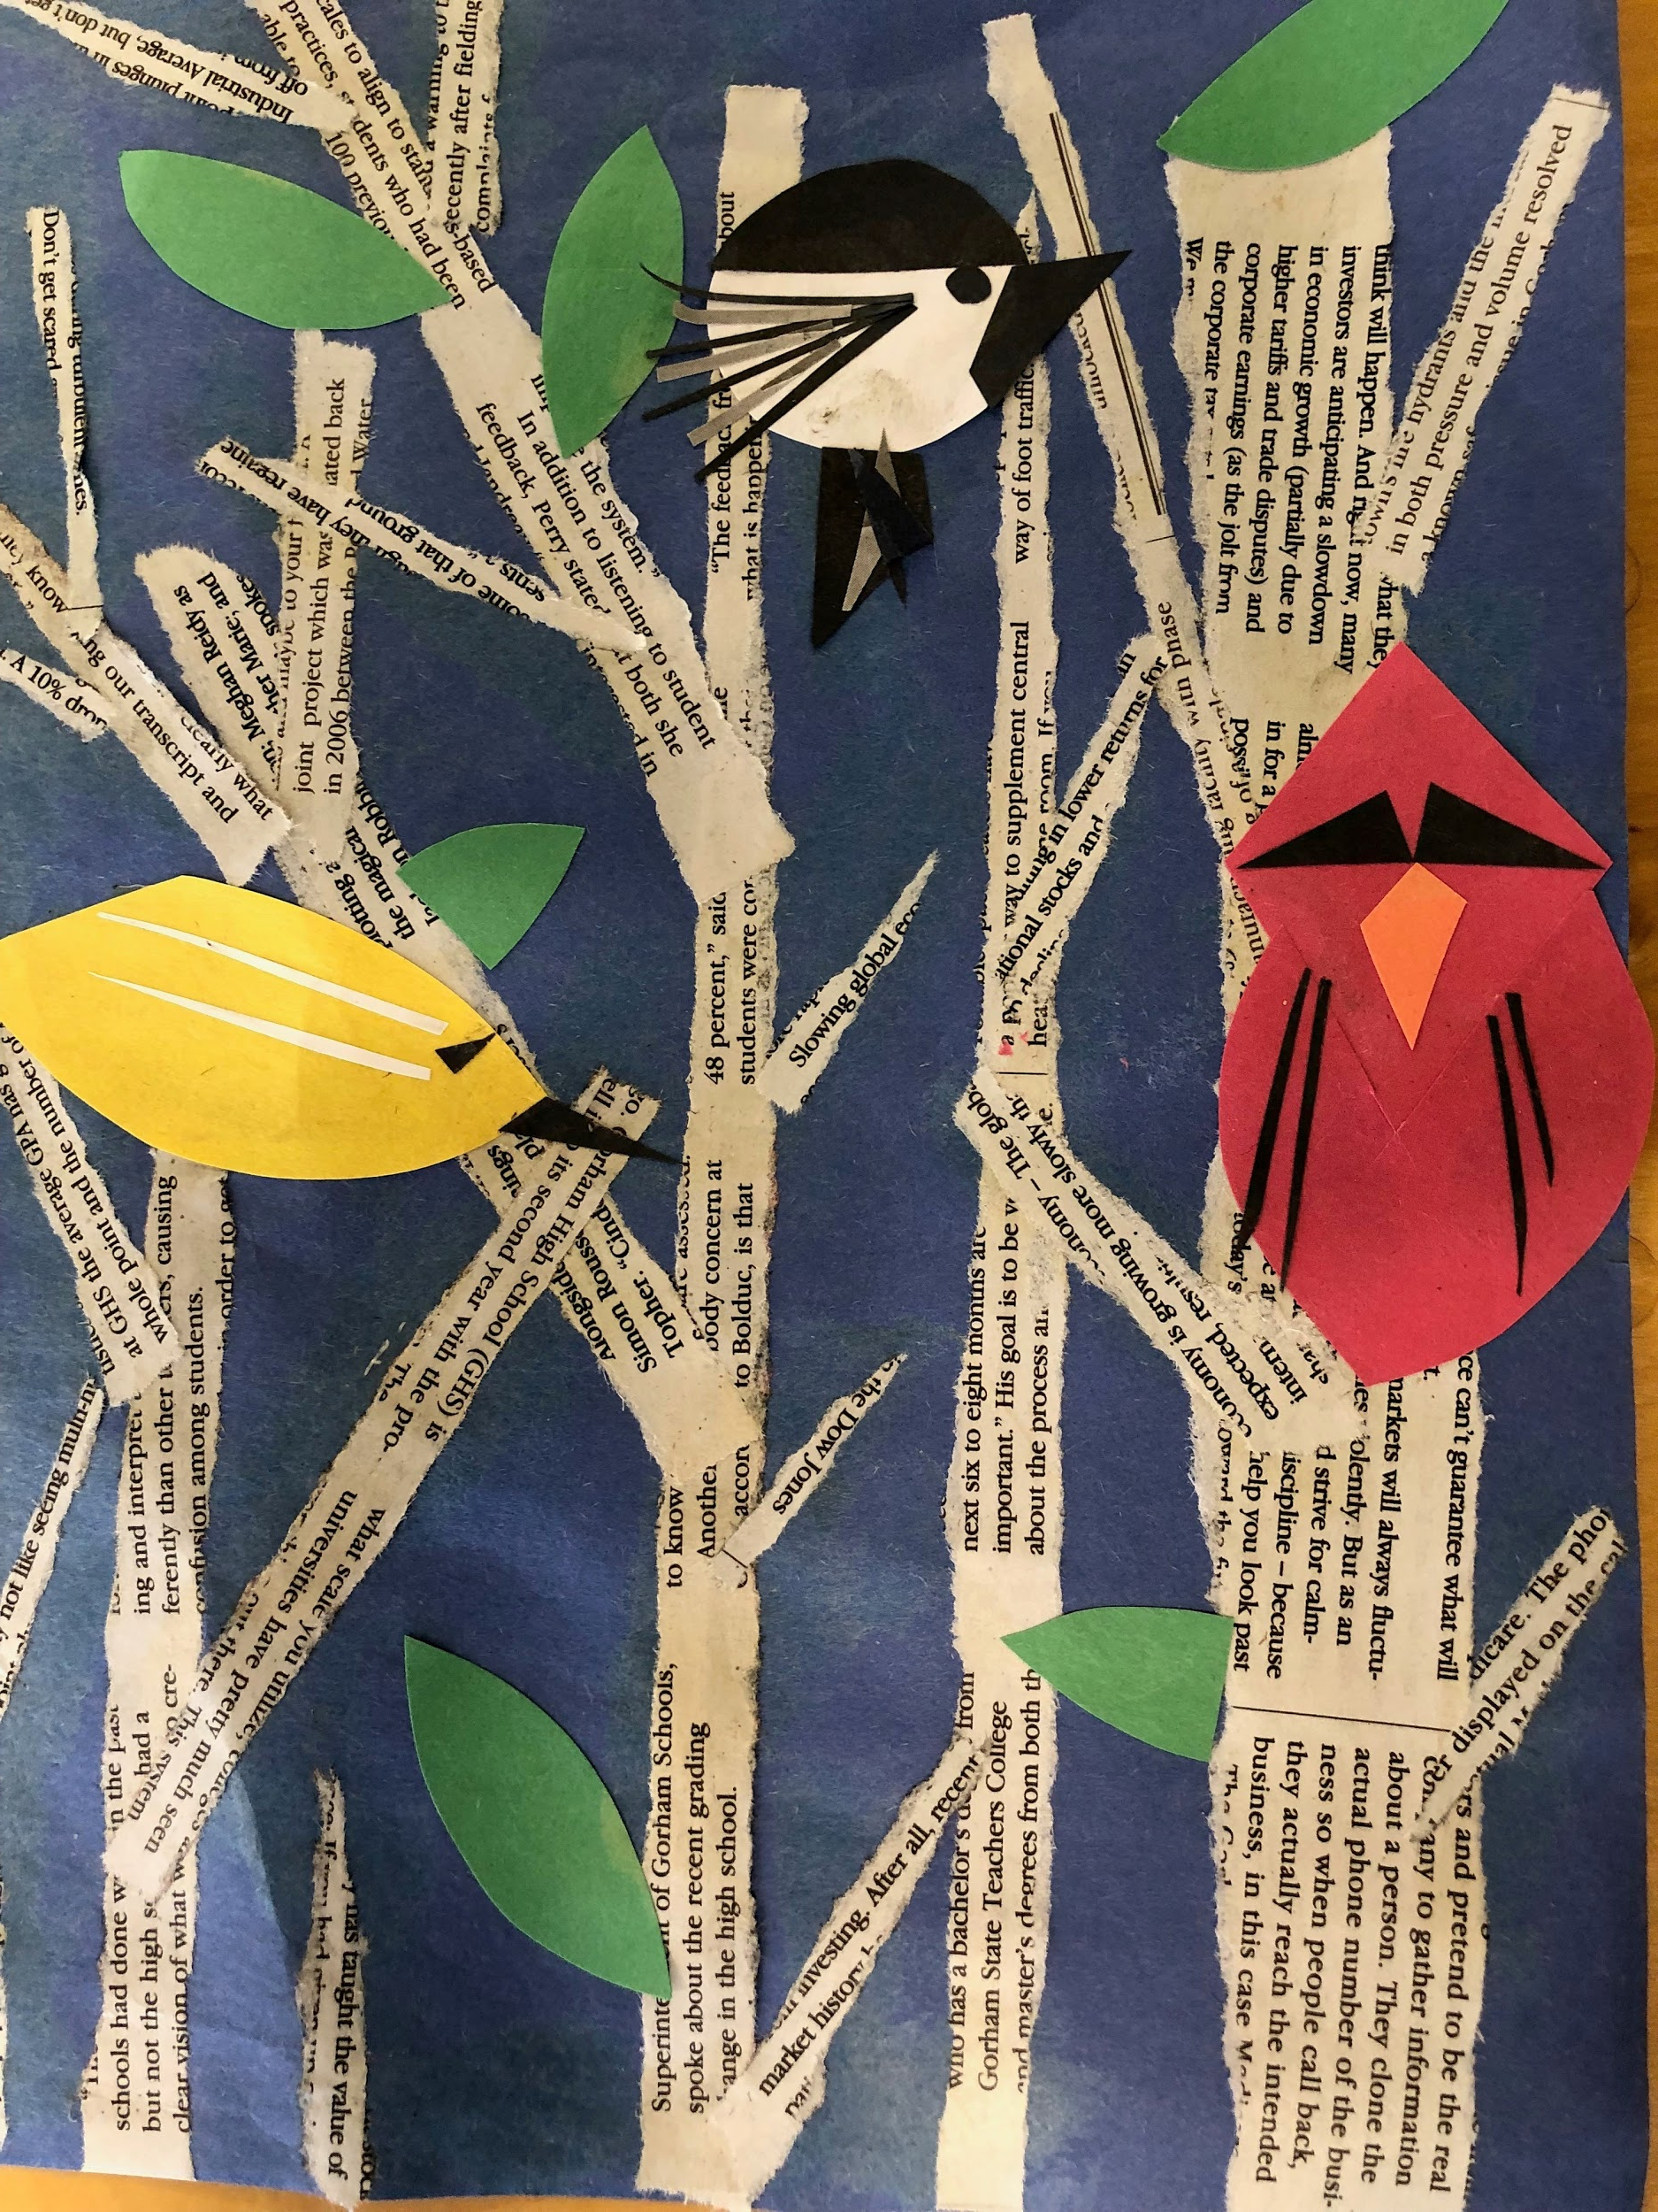
Arts and Crafts
Process art
Still need to observe with glue
Can work in bits of art history
  https://www.alsc.ala.org/blog/2018/01/painting-table-innovative-k-5-art-programs/

Slide 9
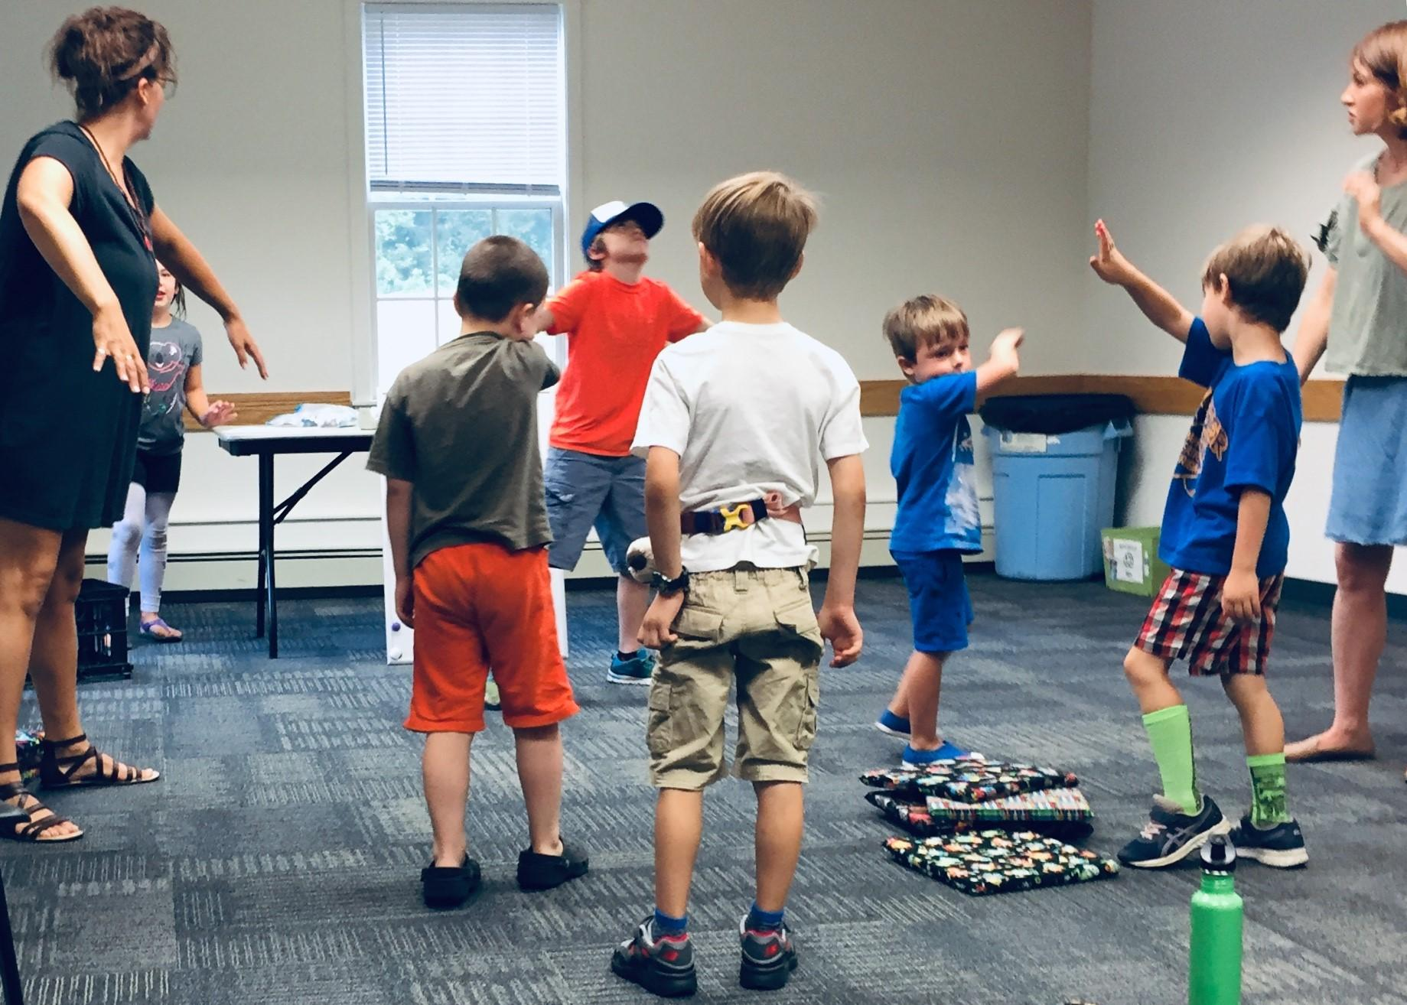
Readers’ Theater
Pick familiar stories that they are likely to already know
In addition to acting out the play, choose simple theater exercises or prop-making.

Slide 10
Early Readers’ Book Club
Pick books from your early readers or fairly easy picture books. Geisel might be a good choice.
Depending on age/skill/outgoing factor: you read, read as a group, take turns reading
Always involve something active or a craft at the end.
Ideas
  https://jbrary.com/early-readers-book-club/

Slide 11
Drive-In Movie
Build a car, then watch a short movie
Creativity and STEM

Slide 12

Other ideas?
What else are you doing?
Do you have favorite resources?
http://mclskids.pbworks.com/w/browse/#view=ViewAllObjects

